Slide 1
Tom Reps - a man with principles -
W from SRW

Slide 2
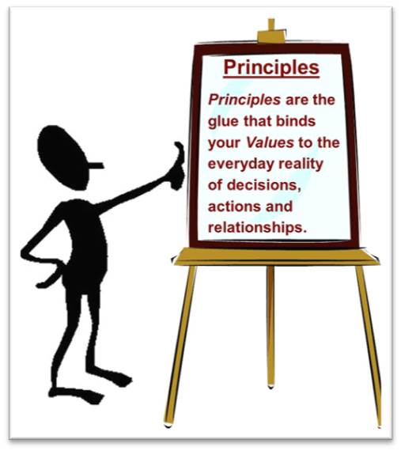
Principles in Principle
Philosophy is the theoretical science
of the first causes and first principles,
Aristotle
Proven assertions of great generality
used to construct the foundations
of an area of science, Brockhaus
Here:
Proven assertions of great generality
used to construct the foundations
of shape analysis, Tom Reps
Tom was in charge of identifying
the principles in shape analysis
He was amazingly productive at that

Slide 3
POPL 98
Instrumentation Principle
Property-Extraction Principle
Sharpening Prinicple

Slide 4
Parametric Shape Analysis TOPLAS 2002
truth-blurring embeddings
Property-Extraction Principle
Instrumentation Principle
Reinterpretation Principle
Abstraction Principle
Sharpening Principle
Astounding increase in number of identified principles,
however with a decrease in the #principles/#pages ratio
3/14 ➔ 6/82, a reduction by almost 70%

Slide 5
How to Explain these Principles to an Uninformed Audience?

Slide 6

Truth-blurring Embedding
Trump’s first principle

Slide 7

The Abstraction Principle
The Donald excels in using abstractions
in his speeches:
Mexicans - rapists
Moslems – terrorists
climate change – a total hoax

Slide 8
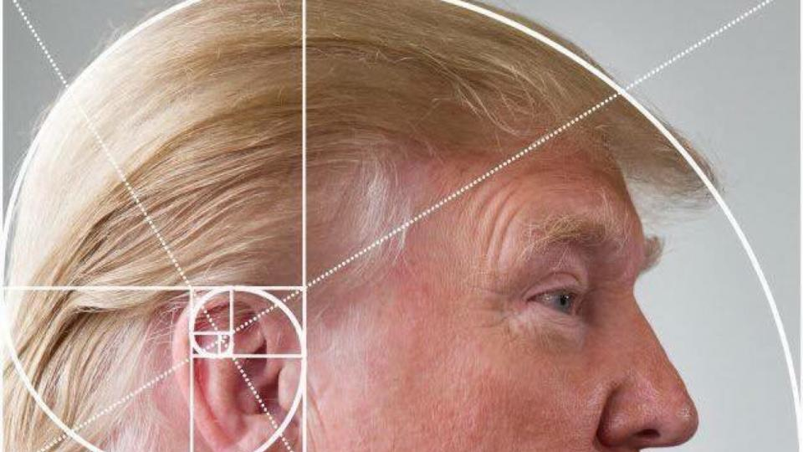
The Instrumentation Principle
Trump instruments
non-definite statements, and
afterwards says ½, don’t know,

Slide 9

The Property-Extraction Principle
Extracting a lot of
money from naïve
students

Slide 10
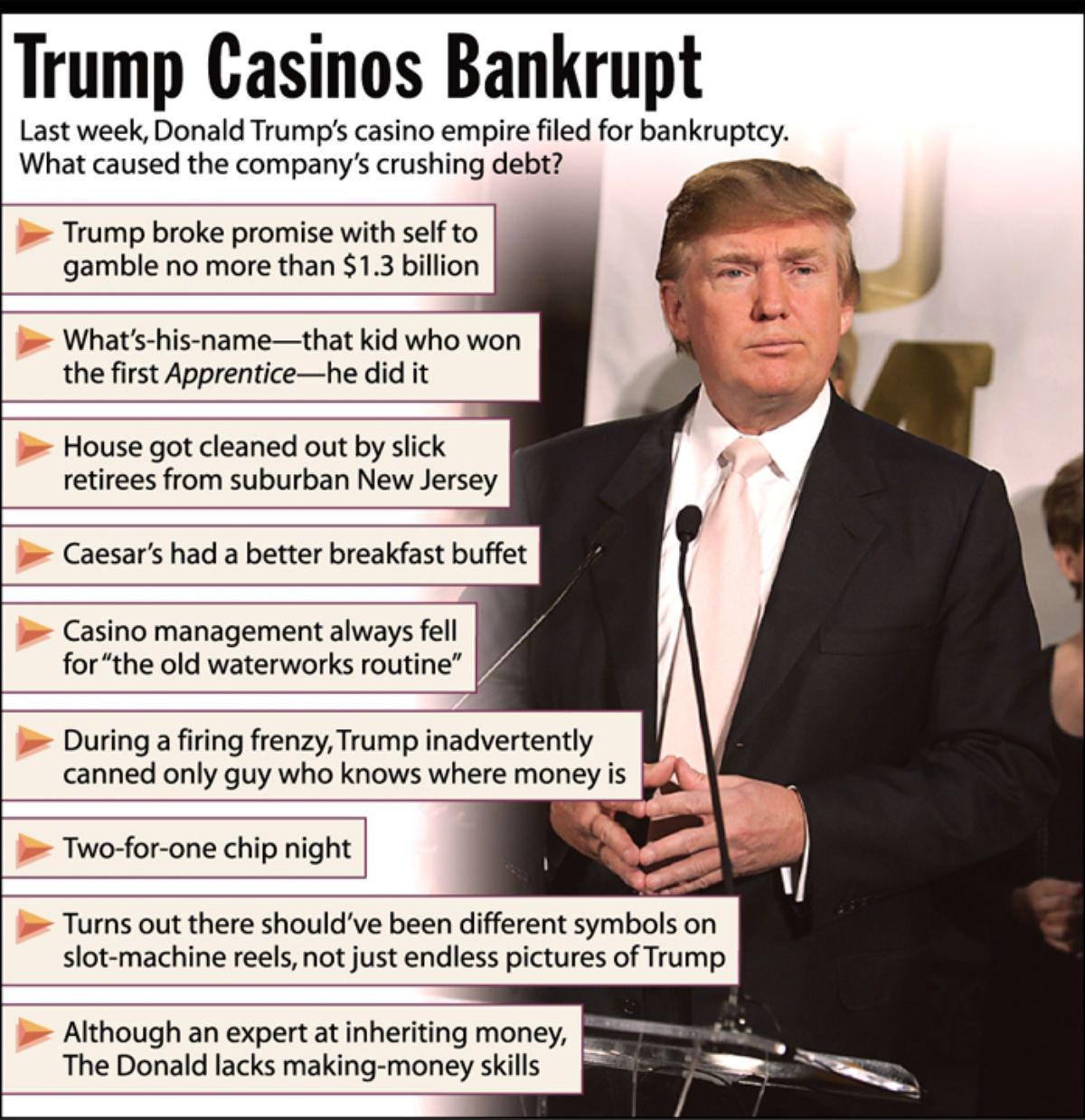
The Reinterpretation Principle
I am worth 8 Billion
Trump’ companies have 650 Mill. debts
NY Times

Slide 11

The Sharpening Principle
Five star steaks instead of
three logical values

Slide 12
PIPe Project
Applied for a US-German project PIPE – Principle-Identification Productivity of Tom Reps
Findings are reported on the following slides

Slide 13
PIPE’s Main Achievement thanks to Christoph Mallon
#! /bin/sh
for DIR in 19?? 20??; do
COUNT="$(for FILE in $DIR/*.pdf; do
../Downloads/xpdfbin-mac-3.04/bin64/pdftotext "$FILE" - 2>/dev/null
done | LC_ALL=C sed -e 's/[Ii]n *principle//g' | grep -iow principle | wc -l)"
N=0
for FILE in $DIR/*.pdf; do
N=$((N + 1))
done
echo "$DIR: $COUNT principles in $N papers"
done

Slide 14
1994: 0 principles in 4 papers
1995: 0 principles in 6 papers
1996: 1 principles in 7 papers
1997: 5 principles in 2 papers
1998: 4 principles in 3 papers
1999: 9 principles in 7 papers
2000: 5 principles in 5 papers
2001: 1 principles in 3 papers
2002: 17 principles in 3 papers
2003: 2 principles in 5 papers
2004: 2 principles in 8 papers
2005: 10 principles in 14 papers
2006: 2 principles in 6 papers
2007: 2 principles in 10 papers
2008: 0 principles in 6 papers
2009: 22 principles in 6 papers
2010: 14 principles in 14 papers
2011: 13 principles in 4 papers
2012: 0 principles in 4 papers
2013: 8 principles in 4 papers
2014: 2 principles in 7 papers
2015: 1 principles in 3 papers
2016: 4 principles in 3 papers
ignoring
IEEE publications
first principles

Slide 15
Tom’s Principle-Identification Productivity
and his Paper-Production Productivity
#papers
x
#principles
x
x
x
x
x
x
x
x
x
x
x
x
x
x
x
year

Slide 16
Tom’s Principle-Identification Productivity
principles including
first principles
x
principles
x
x
x
x
x
x
x
x
x
x
x
x
x
x
x
x
x
x
x
x
x
x
year

Slide 17
Conclusions 1
Need a follow-up project to analyze the huge variation in Tom’s Principle-Identification Productivity

Slide 18
Conclusions 2
It is good
a. to identify principles
b. to start with first principles
c. to have somebody on the team capable of identifying principles
It was very good to work with you, Tom!

